Slide 1
TP Lite is back
Jim Gray

Slide 2
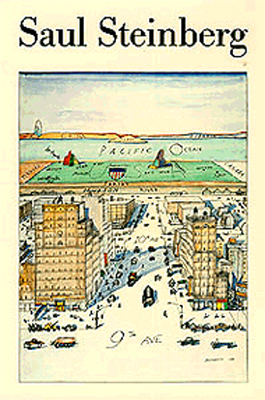

Classic: What’s Outside?
Three Tier Computing
Clients do presentation, gather input
Do some workflow (script)
Send high-level requests to ORB
(Object Request Broker)
ORB dispatches workflows and business objects -- proxies for client, orchestrate flows & queues
Server-side workflow invokes distributed business objects to execute task
Business object read/write database
Presentation
workflow
Business
Objects
Database

Slide 3

DBMS is Web Service!
Client/server is back; the revenge of TP-lite
Web servers and runtimes (Apache, IIS, J2EE, .NET) displaced TP monitors & ORBS
  Give persistent objects
  Holistic programming model & environment
Web services (soap, wsdl, xml)
are displacing current brokers
DBMS listening to Port 80
publishing WSDL, DISCO,WS-Security
Servicing SOAP calls.
DBMS is a web service
Basis for distributed systems.
A consequence of OR DBMS
Presentation
DBMS
Workflow
Business
Objects
Database
Notes:
Databases are encapsulated by business logic. Before the advent of stored-procedures, all the business logic ran in the transaction processing monitor which was the middle tier of the classic three-tier presentation-application-data architecture. With stored procedures, the TP-monitors were disintermediated by two-tiered client/server architectures. The emergence of web-servers and HTTP brought three-tier architectures back to center stage – in part as protocol converters between HTTP and the database client/server protocol, and in part by moving the presentation services (HTML) back to the web server.
As eCommerce evolves, most web clients are application programs rather than browsers blindly displaying whatever the server delivers. Today, most eCommerce clients screen-scrape to get data from the web pages, but there is increasing use of XML web services as a way of delivering data to fat-client applications. Most web services are being delivered by classic web servers today (Apache, Microsoft IIS); but, database systems are starting to listen to port 80 and to publish web services. In this new world, one can take a class or a stored procedure implemented inside the database system, and publish it on the internet as a web service (WSDL interface definition, DISCO discovery, UDDI registration, and SOAP call stubs are all generated automatically). So, the TPlite client-server model is back, if you want it.
Designers still have the option of three-tier or n-tier application designs; but, they now have the two-tier option again. The simplicity of two-tier client/server is attractive, but security issues (databases have huge attack surfaces) may cause many designers to want three-tier server architectures with the web server in the demilitarized zone (DMZ).
It is likely that web services will be the way we federate heterogeneous database systems. This is an active research area. What is the right object model for a database? What is the right way to represent information on the wire? How do schemas work in the Internet? How does schema evolution work? How do you find data and databases? We do not have good answers to any of these questions. Much of my time is devoted to trying to answer these questions for the federation of astronomy databases we call the World-Wide Telescope.

Slide 5
“Everything that can be invented has been invented.”
Commissioner, U.S. Office of Patents, 1899
From http://inventors.about.com/library/lessons/bl_appendix5.htm
…absolutely no basis to support Duell's alleged statement.
Just the opposite is true.
Duell's 1899 report documents an increase of about 3,000 patents over the previous year, and
nearly 60 times the number granted in 1837.
Further, Duell quotes President McKinley's annual message saying, "Our future progress and prosperity depend upon our ability to equal, if not surpass, other nations in the enlargement and advance of science, industry and commerce. To invention we must turn as one of the most powerful aids to the accomplishment of such a result." Duell adds, "May not our inventors hopefully look to the Fifty-sixth Congress for aid and effectual encouragement in improving the American patent system?" These are unlikely words of someone who thinks that everything has been invented.

Slide 6
“We have patents on the Byte and the Algorithm”
Dave Huffman
EE has the electron
Physics has matter/energy
Chemistry has molecules and reactions
Economics has the transaction.
They all need us to do anything

Slide 7
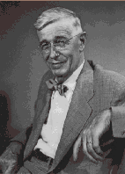
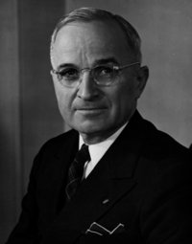
Science The Endless Frontier
Vannevar Bush -> Harry Truman, July 1945
1. Introduction:
  Scientific Progress is Essential
  Science is a Proper Concern of Government
  Government Relations to Science - Past and Future
  Freedom of Inquiry Must be Preserved
2. The War Against Disease:
  In War
  In Peace
  Unsolved Problems
  Broad and Basic Studies Needed
  Coordinated Attack on Special Problems
  Action is Necessary
3. Science and the Public Welfare:
  Relation to National Security
  Science and Jobs
  The Importance of Basic Research
  Centers of Basic Research
  Research Within the Government
  Industrial Research
  International Exchange of Scientific Information
  The Special Need for Federal Support
  The Cost of a Program
4. Renewal of our Scientific Talent:
  Nature of the Problem
  A Note of Warning
  The Wartime Deficit
  Improve the Quality
  Remove the Barriers
  The Generation in Uniform Must Not be Lost
  A Program
5. A Problem of Scientific Reconversion:
  Effects of Mobilization of Science for War
  Security Restrictions Should be Lifted Promptly
  Need for Coordination
  A Board to Control Release
  Publication Should be Encouraged
6. The Means to the End:
  New Responsibilities for Government
  The Mechanism
  Five Fundamentals
  Military Research
  National Research Foundation
http://www.nsf.gov/od/lpa/nsf50/vbush1945.htm

Slide 8
Memex
As We May Think, Vannevar Bush, 1945
“A memex is a device in which an individual stores all his books, records, and communications, and which is mechanized so that it may be consulted with exceeding speed and flexibility”
“yet if the user inserted 5000 pages of material a day it would take him hundreds of years to fill the repository, so that he can be profligate and enter material freely”

Slide 9
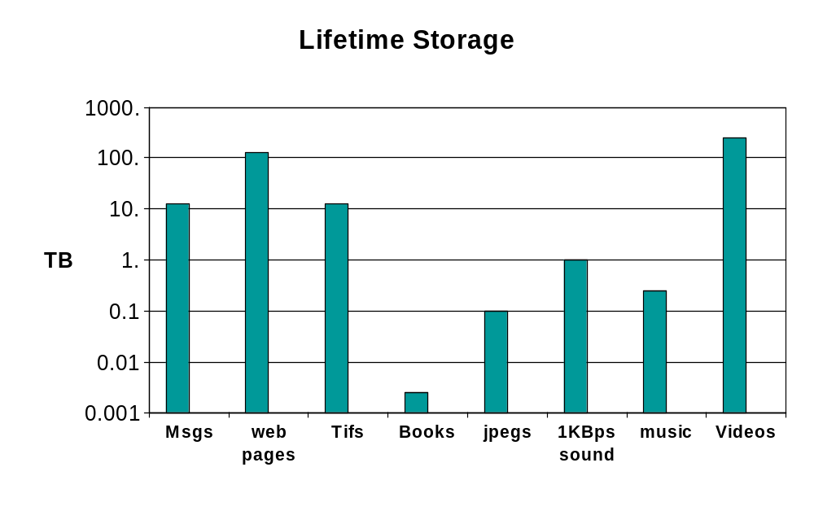
25Kday life ~ Personal Petabyte
1PB
Will anyone look at web pages in 2020?
Probably new modalities & media will dominate then.

Slide 10
Challenges
Capture: Get the bits in
Organize: Index them
Manage: No worries about loss or space
Curate/ Annotate: automate where possible
Privacy: Keep safe from theft.
Summarize: Give thumbnail summaries
Interface: how ask/anticipate questions
Present: show it in understandable ways.

Slide 11
80% of data is personal / individual.
But, what about the other 20%?
Business
  Wall Mart online: 1PB and growing….
  Paradox: most “transaction” systems < 1 PB.
  Have to go to image/data monitoring for big data
Government
  Government is the biggest business.
Science
  LOTS of data.

